Slide 1
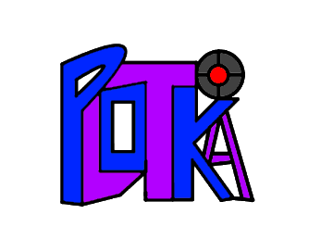
Plotka Final Release Presentation
Alex Litchfield, Anson Decker, Arnav Pawar, Yuecheng Liu, Ziqun Wang, Yihan Shao
Notes:
Note to Grader: To view the real contents of this title slide, please view it in slideshow mode!
Everyone

Slide 2
Marketing
Features
Benefits
Notes:
Yihan

Slide 3
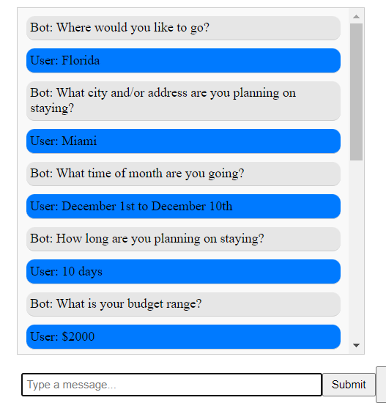
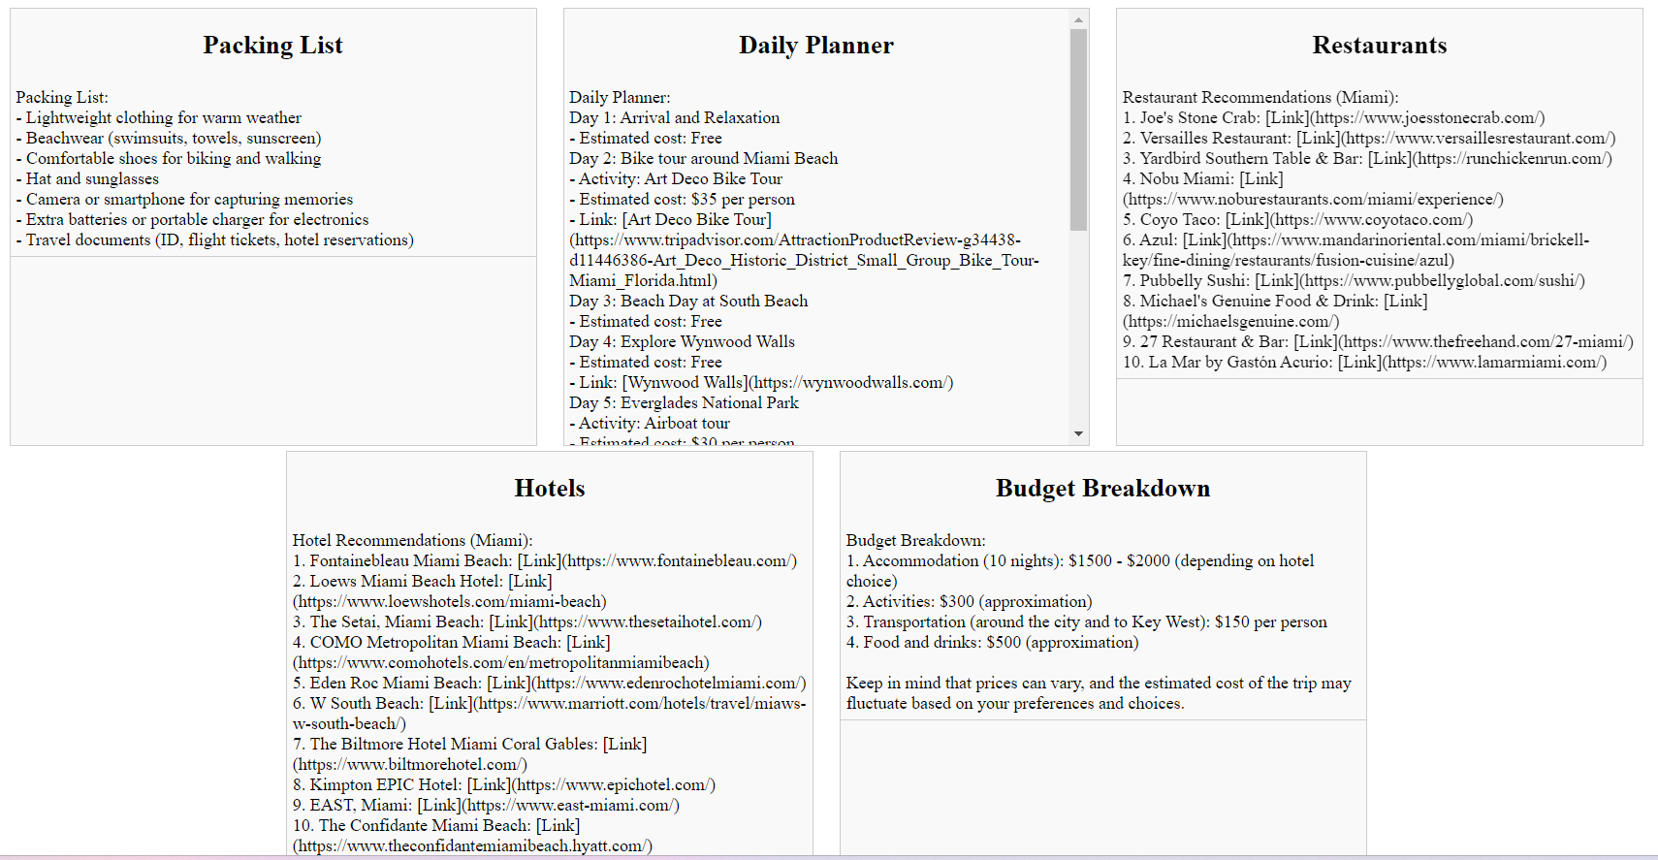
Features
Questionnaire
Packing List
Daily Planner
Restaurant Recommendations
Hotel Recommendations
Budget
Links
Notes:
The Plotka travel chatbot has 7 features which it uses to give users an optimized travel plan. The first of these is the Questionnaire, which is where the chatbot asks the user questions that will allow it to generate a plan to cater to their needs. The user can respond to these questions and view that in the box shown in the top right of the slide. The Packing List gives users a list of items which they should pack for their trip, shown in its own box. The Daily Planner shows users a day to day plan for what they could do during their trip, shown in its own box. The Restaurant Recommendations feature shows users a list of up to 10 restaurants in the area which they can visit on their trip. Similarly, the Hotel Recommendations feature shows users a list of up to 10 hotels in the area which they can stay at on their trip. Each of these are shown in their own boxes as well. The budget feature shows the estimated cost of each activity in the Daily Planner, and also gives a more detailed breakdown in its own box. Finally, the links feature adds links to every restaurant, hotel, and activity shown in the output that has a website. Each of these features helps the chatbot give the user a more tailored experience to their specific needs and requests, while also ensuring that the chatbot can give more accurate information.
Yihan

Slide 4
Benefits
Quick Response
Free
Development
Personalized Recommendations
Ease of Use
Notes:
LIke many other trip planning software and websites, the Plotka Travel chatbot has many benefits. As installable software, it is available to users 24/7. In addition, the chatbot gives quick responses, where in other cases users would have to put in significant time to place their parameters on competing sites. The chatbot also provides personalized recommendations, which will allow users that need special accommodations or requests. The UI is very simple and easy to use, allowing users to figure out how to use the application with ease. Finally, the application is free to download and use.
ARNAV

Slide 5
Technical
Development
Implementation
Strategy
Notes:
Alex

Slide 6
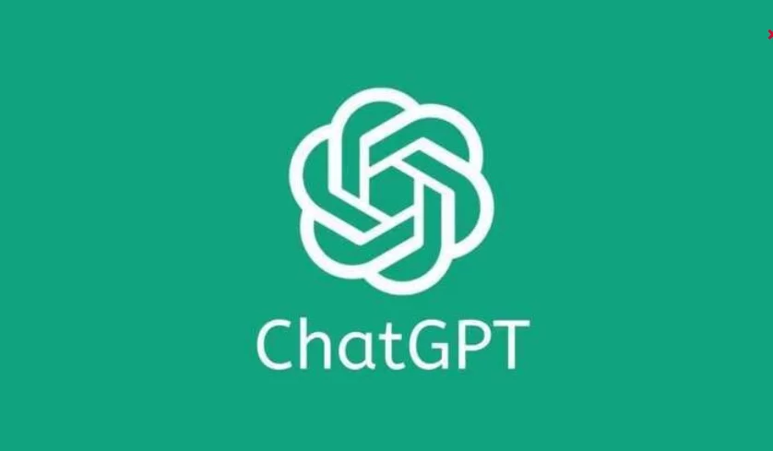
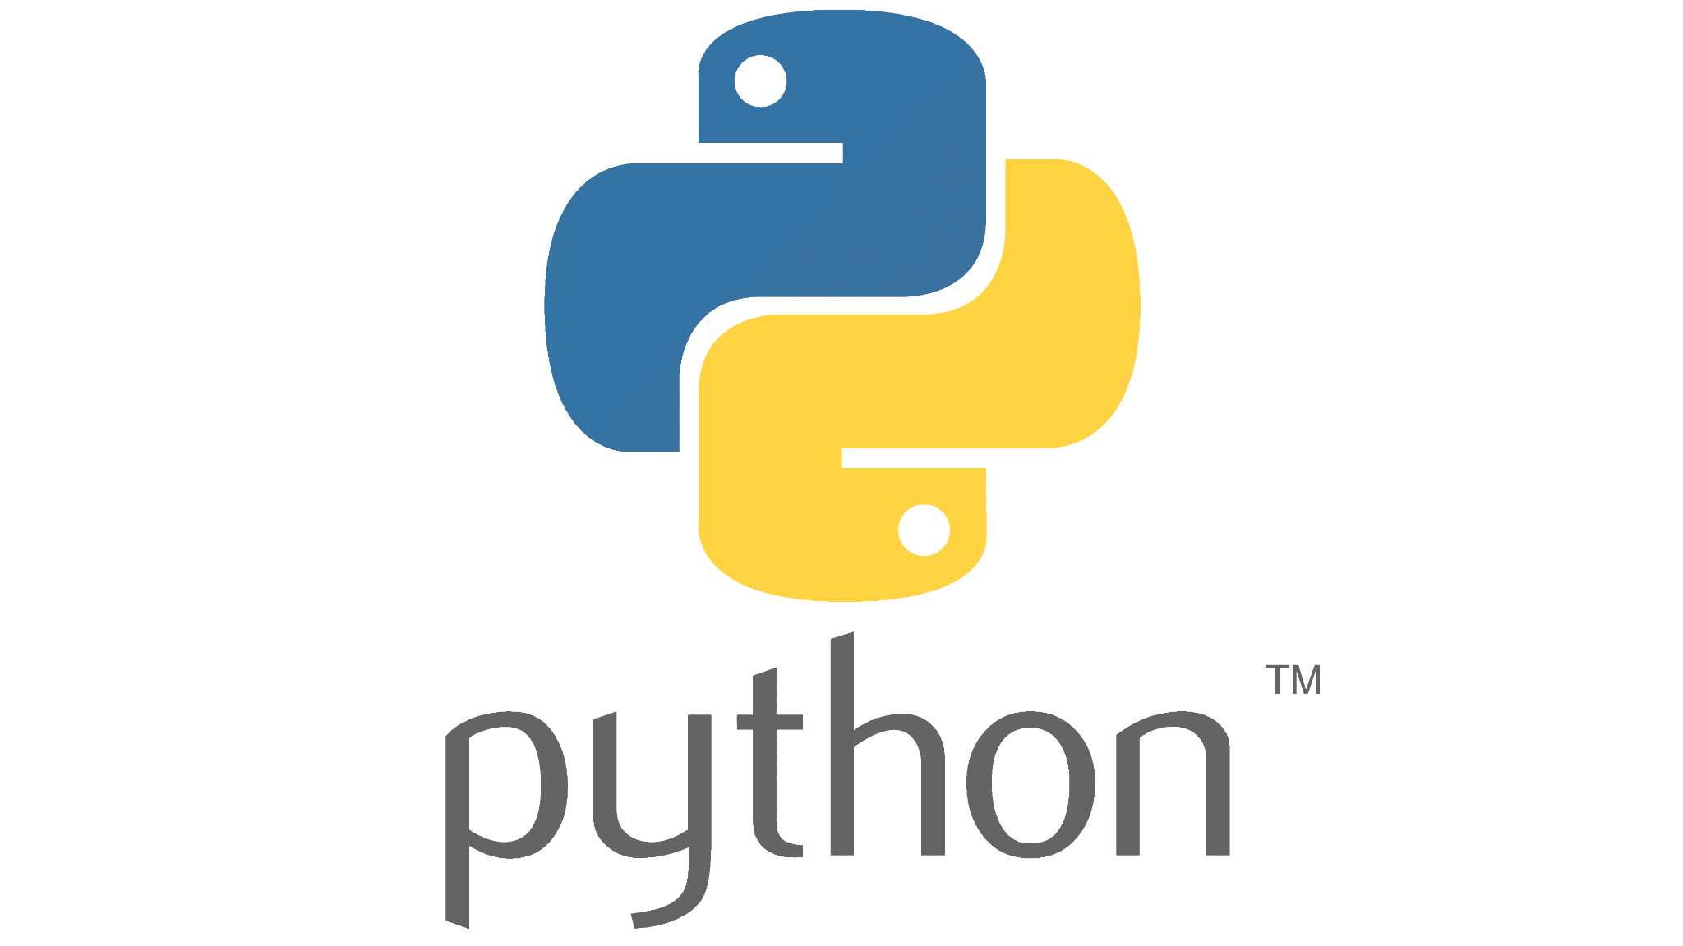
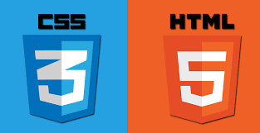
Development Strategy
Backend Development
  ChatGPT API understanding/usage
  Python understanding/usage
  Questionnaire Feature
  Packing List Feature
  10 Restaurant Recommendations Feature
  10 Hotel Recommendations Feature
  Daily Planner Feature
  Budget Breakdown Feature
Front End Development
  HMTL and CSS understanding/usage
  Input box
  Adding our logo
  “Submit” and “Clear Chat” buttons
  Separating output into 5 sections:
Notes:
(HAVE LIVE APPLICATION OPEN BUT NO INPUT TEXT IN IT ON THE SIDE)
When developing our application, we prioritized developing our backend first. We knew going into the project that we could be utilizing the ChatGPT API as our chatbot would rely on ChatGPT’s capabilities. We then decided that we would use Python to develop the program as most of us had substantial knowledge of the language and its libraries. We ended up using the Flask, Views, and OpenAI python libraries in our program. The first feature we implemented was our Questionnaire Feature, which is what allows the user to answer questions provided by the chatbot. The Packing List, Restaurant Recommendations, and Hotel Recommendations features were more or less developed simultaneously as they each only relied on the Questionnaire Feature. However, our Daily Planner feature was only implemented once each of the other 3 were completed, as it could only use information from the 3 previous features to provide an accurate output. Finally, our Budget Breakdown Feature was developed after the completion of the Daily Planner, as the budget was created based off of the activities within the Daily Planner.
While developing our backend, we decided to begin light development of the front end to make our own tests of the application more similar to those who would actually use it in the future. Our front end was created using HTML and CSS and showcases the questions asked by the chatbot as well as the user’s answers in a large textbox. Above that we feature our logo. Underneath the textbox we have a small textbox where users can input their answers to the chatbot’s questions. There are also 2 buttons, “Submit” and “Clear Chat”. “Submit” simply feeds the user’s answer from the textbox to the chatbot. This can also be done using the “Enter” key on the keyboard though. The “Clear Chat” button clears the previous inputs given to the chatbot from both memory and the visual textbox representation above. Finally, our front end had to be able to showcase the chatbot’s output. We did this by separating each output into its own section. These sections are Packing List, Daily Planner, Restaurants, Hotels, and Budget Breakdown.
ALEX

Slide 7
Application Back End
User Input
Chatbot
Hotel
Budget
Restaurant
DailyPlanner
PackingList
Notes:
Our application utilizes six classes to store, manipulate, and generate information. Our chatbot class is the most complex, which collects the responses from the user and generates answers for each feature. The other 5 classes, which are DailyPlanner, PackingList, Hotel, Restaurant, and Budget, take in that information and organize it in a presentable manner, while also parsing it to double check that the chatbot has not made a large error. The 5 smaller classes are declared through a factory method in the chatbot class, which allows the program to efficiently create objects that store user information. This implementation method allows our users to receive information faster.
ALEX

Slide 8
Application Front End
Logo
Buttons
Output Text Boxes
Input Text Box
Notes:
Our application’s front end was fairly simple. It consists of the Plotka logo, an input text box for user responses, interactive buttons that allow the user to submit their answers or clear previous ones, and output text boxes that displayed the chatbot output in a clear and organized manner. Each output textbox displays its contents in lists to give users a clear view of the answers provided, as paragraph form, which we used originally, was a jumbled mess that no one could read.
(NEXT SLIDE SHOWS THE UI OF THE APPLICATION)
Arnav

Slide 9
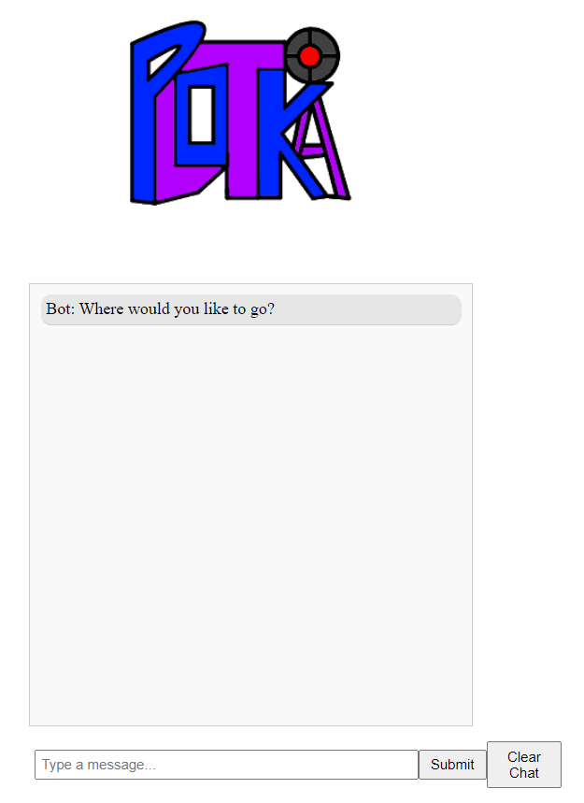
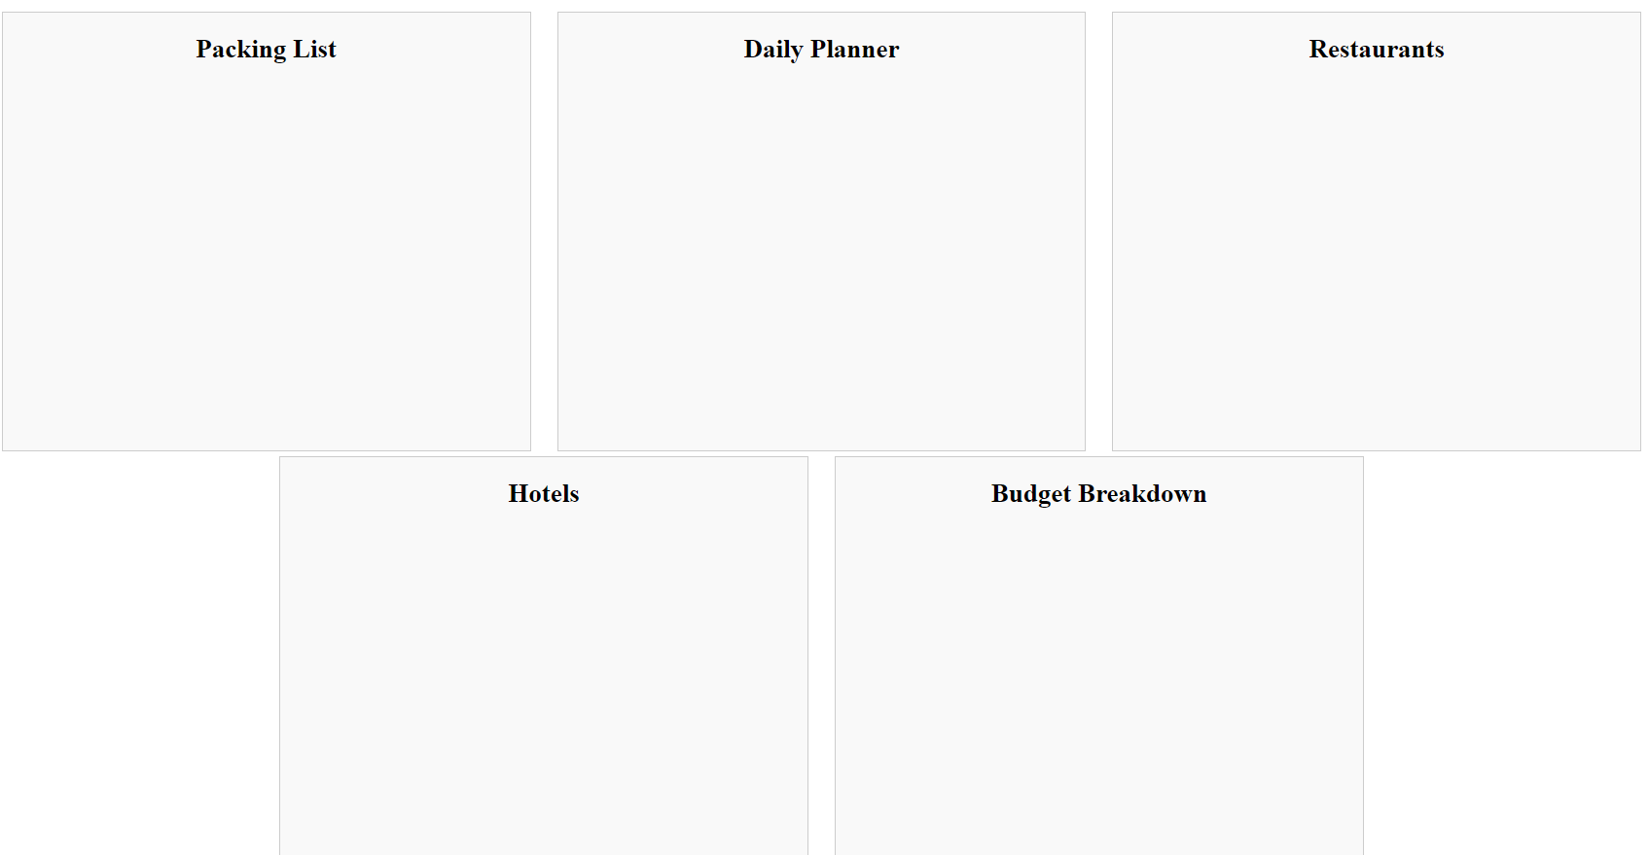
Notes:
Show this and then move on
Arnav

Slide 10
Future of the Application
Development
Enhancement
Version 2.0
New Feature
Notes:
Yuecheng

Slide 11

Future of Application
For our next version, we are considering adding the new feature and enhancement.
New Feature: Flight Recommendation
Enhancement: UI Improvement
Overall, by combining the powerful Flight Recommendation feature with an user-centric UI, Plotka aims to provide a better travel planning solution.
Notes:
For our next version, we are considering adding the new feature and enhancement.
Flight Recommendation: Given the user's specified destination, start location, and expected departure and arrival times, plotka can then help the user to gather flight information. Thus, our chatbot will sift through vast databases, considering factors such as cost, duration, and user preferences to create a list of the top 10 flights, ensuring a tailored and efficient travel planning experience.
Our website's UI enhancement focuses on delivering a modern and intuitive design. A clean, uncluttered interface will enhance the overall user experience, making it easy for both new and returning users to navigate conveniently.
Overall, by combining the powerful Flight Recommendation feature with a user-centric UI, Plotka aims to provide a better travel planning solution.
Yuecheng

Slide 12
Group Dynamics
Organization
Flexibility
Roles
Notes:
Ziqun

Slide 13

Group Dynamics
We develop and test the FrontEnd and BackEnd separately
When both parts are done, they are combined for a complete application
Front End : Yihan Shao, Arnav Pawar
Back End : Ziqun Wang, Yuecheng Liu
Testing : Anson Decker, Alex Litchfield
Github is used to manage our project with each of us having a branch. We work on different tasks over the course of the week and merge our branches
New tasks are assigned weekly to make sure all team members know clearly what to do the next week
Notes:
For our product, the front end and back end were developed separately. In the end, we combined them to create our application. Each person was assigned a general role related to the application. Yihan and Arnav worked on the front end, Ziqun and Yuecheng worked on the back end, and Anson and Alex worked on testing. We used github to manage our project and had different branches which we later merged to created our main product. New tasks were assigned weekly so that group members clearly knew what they had to do
Ziqun

Slide 14

GitHub & GitHub Issues
Github Repositories
Github allowed us to view, edit, and share our developments and progress on the code
Allowed us to merge files and overwrite old ones
Github Issues
Allowed us to record and report bugs or problems to the team
People can resolve these when completed
Notes:
We used Github and Github issues to store our code. Github allowed us to view, edit, and share any developments that we made while working on the code. Additionally, we were able to merge files and overwrite old ones, which we had to do whenever someone even made a tiny bit of progress. Github issues allowed us to record, display, and reports any issues that we had with the software. This includes bugs, opinions on directions things should go, class development, and so on. We also used Pylinter, which is a linter that was made for python programs. This allowed us to maintain a coding standard across all versions of our code.
Ziqun

Slide 15
What Worked (Or Did Not)
Instruction
Communication
Assignments
Notes:
Anson

Slide 16


What Worked/Didn’t Work
Planning
Task Assignment
Communication
Notes:
Regarding what did and didn’t work for us during this project, we can all agree that utilizing Trello and Discord was very effective for our group. We were able to efficiently plan out our work and divide tasks amongst ourselves. This led to very efficient communication which helped with keeping us all on the same page with our goals. Trello was great for keeping our deadlines in check and visualizing our progress so far, while discord was better for our communication as a group.
Our weekly meetings were also very efficient, everyone was cooperative and when it came to dividing the work amongst ourselves we were more likely to offer help instead of waiting for someone else to jump in. Everyone was also very eager to express their vision for how the project should be developed. Even when we had disagreements regarding how a feature was to be developed, we were able to reach a compromise and work with each other instead of shutting out someone’s idea.
Choosing languages that we were all moderately comfortable with also played a part in making sure this project went smoothly. We were all comfortable reading through the code and finding any syntax errors or alternative ways to implement features. If we were to have picked languages only one or two members were comfortable with I don’t think we would’ve found the same success in our project.
Now for what didn't work, Our coding collaboration wasn’t exactly ideal and we could have better utilized github for keeping a well maintained codebase. The linter was helpful in making sure the code was styled correctly despite the differences between branches, but there should have been a better structured main branch earlier in the project. Luckily this didn’t set up back a crazy amount, but it was tricky to deal with in some versions of the release.
Overall I think that each step we took in our project was a step forward, there were some times where things we slow and we getting instant results but we were never ruining our progress made. So if I were to go back and do things differently I don’t think I would make a drastic change.
Anson

Slide 17
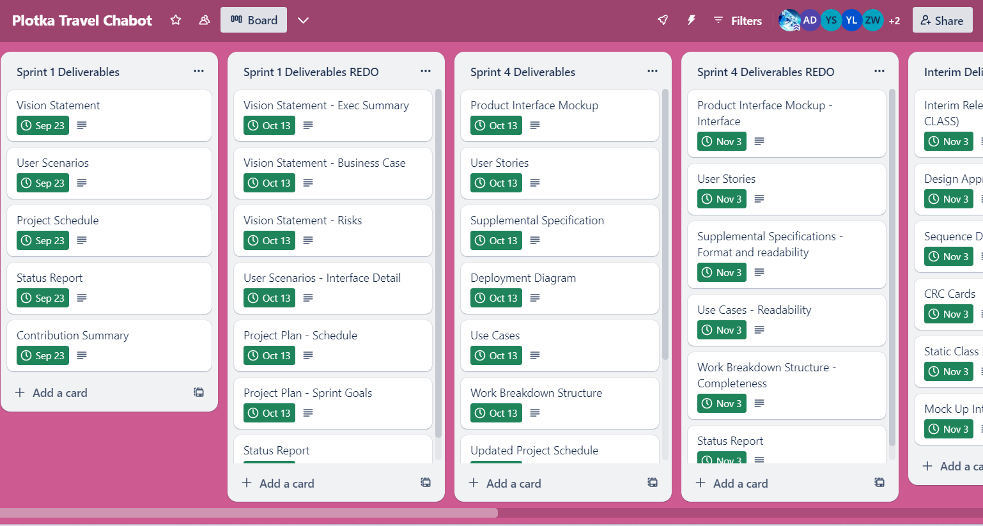
Trello
Notes:
As one of the most useful tools for our project, i’d like to talk a bit about Trello. Trello acted like a calendar which allowed us to see due dates, assignment names, and their description (which was taken directly from the syllabus). We also were able to check off individual assignments when they were completed, letting group members know that this portion of the deliverables were completed. We chose to use this website to keep track of our assignments because it was free, simple to use, and had a very navigable and straightforward user interface, and we believed that having a reliable way to keep ourselves accountable would help us all to meet deadlines and stay on top of work. As for discord, we won’t go into that because I HOPE everyone here knows about discord and its features. (get a show of hands of people who have used discord before, and people who used discord during this project).
ANSON

Slide 18
Course Reflections
Deadlines
Preparedness
Collaboration
Real World Application
Notes:
Everyone

Slide 19
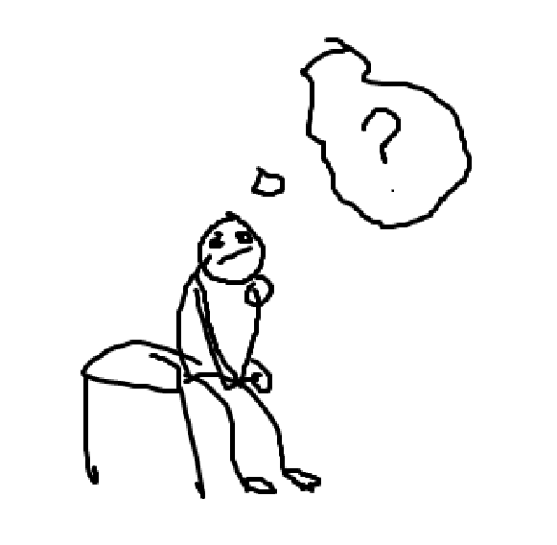
Reflection on the Course
Notes:
Alex: In this course I gained an understanding of the Scrum methodology and learned about common documentation practices such as Business cases, Personas, User Scenarios, and User Stories. I also learned a great bit about collaborating with a group for a coding project, as I had never done that before.
Anson: I enjoyed being able to see something go from an idea into a tangible final product. Learning that there is so much more to a project than just the code itself gave me a brand new perspective on project development and how much thought needs to go into planning and testing.
Arnav: This class taught me a lot about the scrum methodology as well. This was my first ever time using this methodology and I feel like it has prepared me really well for my future in computer science. I feel like I can work on different projects with bigger team and have a strong understanding on how to collaborate and develop something efficiently to reduce the strain on the overall team.
Yuecheng: In the Software Design & Documentation course's group project, I not only improved my practical coding abilities but also gained valuable insights into effective communication and collaboration with team members. Above all, I realized the crucial importance of thorough documentation for the success of a project.
Ziqun: In previous classes, mostly what I did were individual homework or simple group work, which I think is far away from what we will face in real life. However, in this class, I learned a lot about how to complete an entire project with my team members
Yihan: In the past, I like to complete tasks alone, but I realize that cooperation is very important. After all, one person cannot master all the skills, and only communication can acquire new knowledge.
EVERYONE

Slide 20
Sources
https://cms.rootstack.com/sites/default/files/inline-images/Python-Symbol_1.png
https://blog.logomyway.com/wp-content/uploads/2023/08/chatgpt-logo.png
https://miro.medium.com/v2/resize:fit:1200/0*pxb9-4jdzxSp1K5Y.png
https://encrypted-tbn0.gstatic.com/images?q=tbn:ANd9GcTGvBkbnHUDax7JvpD-qs8Y_MKrD8ncQfJDSw&usqp=CAU
https://www.teambonding.com/wp-content/uploads/2022/02/Depositphotos_79692920_L.jpg
https://encrypted-tbn0.gstatic.com/images?q=tbn:ANd9GcQ7d7pBYgG7CVXeqI4_0ZgG7CaZaeb9wr6KPg&usqp=CAU
https://www.lflegal.com/wp-content/uploads/2021/09/discord-new-logo.jpg
https://1000logos.net/wp-content/uploads/2021/05/GitHub-logo.png

